Slide 1

Department of Information Technology
Mini Project(IT2409) Final Seminar on
BACKGROUND REMOVAL IN VIDEO
Undertaken At
Zoho
Session 2021-22
By
(02)Ms. Aditi Subhash Nimbarte
(18)Ms. Pranjali Dharmadip Jambhulkar
(63)Mr. Sanket Suhas Tinkhede
Prof. Amol Gaikwad
Academic Guide

Slide 2
Outline
Abstract
Aim and Objective
Introduction
Diagrams
Modules
Experimental results/Output/Snapshots
References

Slide 3
Abstract
We live in the era of video calls. Conducted over the internet and using whatever camera that comes with your laptop or computer, we broadcast our lives to our classmates, coworkers, and families.
Sometimes, though, we don’t want to broadcast our space.
As a result, video meeting software includes a feature to hide our background, usually behind an image of our choice. While most don’t think of it much, the actual task of determining what determines the foreground and the background in an image is hardly trivial.

Slide 4
Aim and Objective(s)
Aim: Removing background from a real-time video while keeping the target object in focus and removing background from a picture.
Objectives:
Implementation of background removal program.
Replacing background for a better look.
Faster rendering for better focus on person/object.

Slide 5
Introduction
The background of the video needs to be modified as there are so many other interruptions in the background or the background color doesn’t suit the person due to which background or the color needs to be modified.
We have used Python inbuilt modules such as OpenCV, CVzone2 and mediapipe’s selfie segmentation model.
OpenCV is an image processing library for python.
OpenCV contains more than 2500 image processing algorithms.

Slide 6
Introduction
Cvzone is a computer vision package that makes us easy to run like face detection, hand tracking, pose estimation, etc., and AI functions.
The MediaPipe is a kind of open-source framework that can be used in the preparation of ML solutions for a real-time video.
The Segmentation is actually a classification task, in the sense of classifying every pixel to a class.

Slide 7
Introduction
Semantic segmentation:
- every pixel is classified as a label
pixel of same class cannot be differentiated according to the different object it belongs.
Instance segmentation:
- only the specific class pixels will be labelled ,only the ones that we want to classify.
pixels can classify objects as well.
Selfie segmentation:
- can be called as mix of semantic and instance segmentation.
- more prominently segments people in focus from the image.

Slide 8
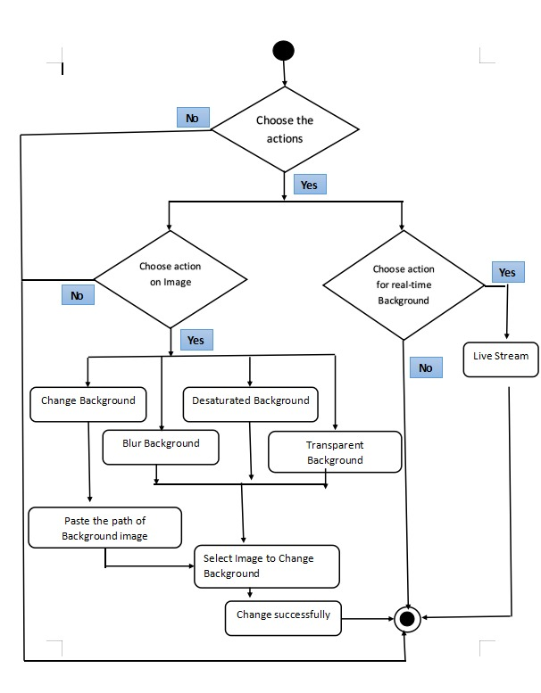
Diagram
Fig: Activity diagram

Slide 9
Modules –MobileNetv3
MobileNetV3: The latest improvements to the MobileNets architecture were summarized in a research paper published in August this year.
The main contribution of MobileNetV3 is the use of AutoML to find the best possible neural network architecture for a given problem.
MobileNetV3 is the third version of the architecture powering the image analysis capabilities of many popular mobile applications.

Slide 10
Modules - Mediapipe
Mediapipe: The MediaPipe is a kind of open-source framework that can be used in the preparation of ML solutions for a real-time video.
Mediapipe also facilities the deployment of machine learining technology into demos and applications on wide variety of different hardware platforms.
MediaPipe has various pre-trained models inbuilt. Recently

Slide 11
Modules - CVzone
CVzone: Cvzone is a computer vision package that makes us easy to run like face detection, hand tracking, pose estimation, etc., and AI functions.
OpenCV is an image processing library for python. It is the most popular library for image processing and computer vision tasks because it is open source and very fast.
OpenCV contains more than 2500 image processing algorithms.

Slide 12
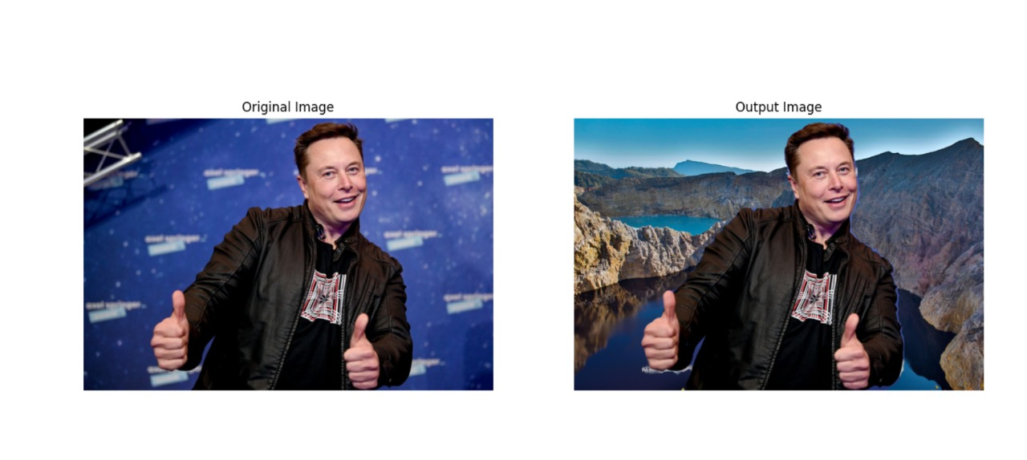
Experimental results/Output/Snapshots

Slide 13
Experimental results/Output/Snapshots

Slide 14
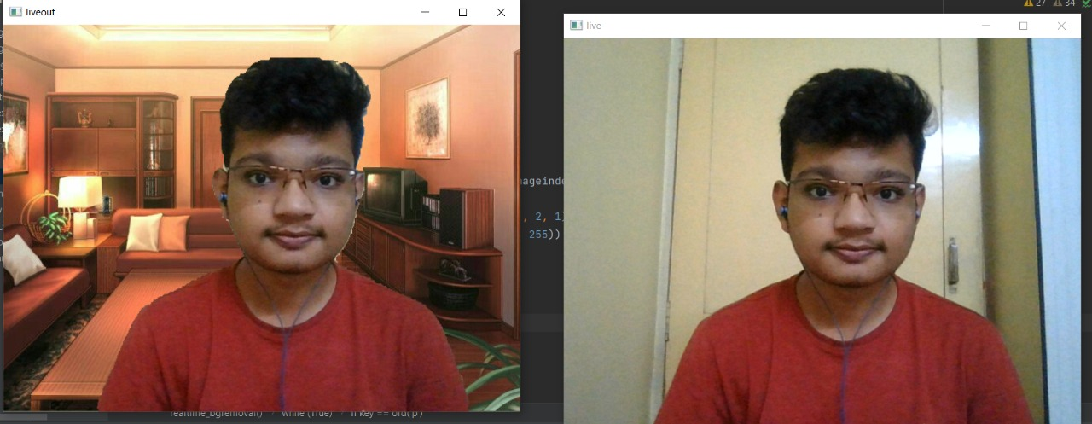
Experimental results/Output/Snapshots

Slide 15
References
Website
[1] “ MediaPipe Selfie Segmentation”, https://google.github.io/mediapipe/solutions/selfie_segmentation.html
[2] “Background removal with deep learning”,https://towardsdatascience.com/background-removal-with-deep-learning-c4f2104b3157
[3] “Background Removal with Python”, https://towardsdatascience.com/background-removal-with-python-b61671d1508a
Journal
[4] Yong Xu, Jixiang Dong, Bob Zhang, Daoyun Xu, “Background modeling methods in video analysis: A review and comparative evaluation”, https://doi.org/10.1016/j.trit.2016.03.005, Volume 1, Issue 1, January 2016.
Conference
[5] Siying Qian; Chenran Ning; Yuepeng Hu, “MobileNetV3 for Image Classification”, https://ieeexplore.ieee.org/document/9389905, 26-28 March 2021
Tech Report
[6] Liubov Zatolokina, “Deep Learning-based Background Removal And Blur In A Real-Time Video” https://mobidev.biz/blog/background-removal-and-blur-in-a-real-time-video, Feb 22, 2021
Thesis
[7] Lorena de los Angeles Guachi Guachi,"Background Subtraction for moving object detection", http://dspace.unical.it:8080/jspui/bitstream/10955/1308/1/Thesis-Background%20Subtraction%20for%20moving%20object%20detection.pdf
[8] Ahmed Mohammed Ahmed Madani, “Moving objects detection using background subtraction technique", http://api.uofk.edu:8080/api/core/bitstreams/c9e0b3de-c36a-41a2-b2e6-2acccffcb9b6/content,July 2011

Slide 16
Thank You…….

